Slide 1
Pharmacy Benefit Management(PBM) Optimization
Project Team:
Asvanth.S
Jeevashri.S
Santhanalakshme.NS
Roshini Nivada.P
Ganesh.P
Karthikeyan.C

Slide 2
Introduction to Understanding the PBM
What is Pharmacy Benefit Management (PBM)?
Key functions of PBMs:
Formulary management: Designing drug lists to manage costs and efficacy.
Claims processing: Adjudicating prescription drug claims efficiently.
Rebate negotiation: Securing discounts from drug manufacturers.
Clinical programs: Supporting appropriate medication use and patient outcomes.
The complex ecosystem: Payers, pharmacies, manufacturers, and patients.
The need for optimization: Addressing the challenges of rising drug costs, administrative inefficiencies, and ensuring patient access.

Slide 3
Usecase: Addressing Rising Drug Costs and Inefficiencies
High expenditure on specialty and high-cost medications: These represent a significant portion of drug spend.
Lack of transparency in PBM pricing and rebate structures: Makes it difficult to assess true cost-effectiveness.
Suboptimal formulary design leading to higher out-of-pocket costs for patients: Patients may be steered to more expensive alternatives.
Inefficient claims processing and adjudication: Can lead to delays, errors, and increased administrative overhead.

Slide 4
Technology Stack for PBM Optimization
Data Analytics Platforms: For deep analysis of claims data, cost trends, and utilization patterns to identify optimization opportunities.
Machine Learning (ML) and Artificial Intelligence (AI): Enabling predictive modeling, fraud detection, personalized patient interventions, and intelligent automation.
Cloud Computing: Providing scalable infrastructure for data storage, processing, and accessible deployment of PBM solutions.
APIs and Integration Tools: Ensuring seamless and real-time data exchange between PBM systems, payers, pharmacies, and other healthcare stakeholders.

Slide 5
Proposed Solution: A Data-Driven PBM Optimization Strategy
Leveraging advanced analytics to identify cost-saving opportunities and optimize contract terms.
Implementing AI-powered formulary optimization and dynamic price benchmarking to ensure competitive pricing.
Developing personalized patient programs using AI to improve medication adherence, manage chronic conditions, and reduce waste.
Streamlining claims processing and adjudication with intelligent automation and fraud detection mechanisms.

Slide 6
Key Components of the Optimization Solution
Predictive Cost Modeling: Forecasting drug spend and identifying high-impact interventions with advanced statistical methods.
Rebate Transparency Dashboard: Interactive visualization of rebate flows, ensuring fair and accurate accounting and identifying optimization opportunities.
Personalized Medication Management: AI-driven recommendations for optimal drug selection, dosage, and adherence support tailored to individual patient needs.
Pharmacy Network Analysis: Optimizing pharmacy network design and performance based on cost, access, and quality metrics.
Real-time Claims Auditing: Proactive identification and prevention of errors, waste, fraud, and abuse in claims processing.

Slide 7
Benefits of PBM Optimization
Significant reduction in overall drug spend for payers and employers, leading to substantial cost savings.
Improved transparency and trust in PBM operations, fostering stronger relationships with stakeholders.
Enhanced patient access to necessary medications at lower out-of-pocket costs, improving affordability and equity.
Increased operational efficiency and reduced administrative burden through automation and streamlined processes.
Better health outcomes through improved medication adherence, effective disease management, and personalized care.

Slide 8
Conclusion and Next Steps
PBM optimization is no longer a luxury but a necessity for a sustainable and value-driven healthcare system.
Adopting a data-driven and technology-enabled approach is paramount to achieving tangible results.
Next Steps:
Identify specific areas for pilot program implementation.
Engage key stakeholders for alignment and buy-in.
Establish clear metrics for continuous monitoring and performance evaluation.
Questions and Discussion: Open the floor for your valuable input.

Slide 9
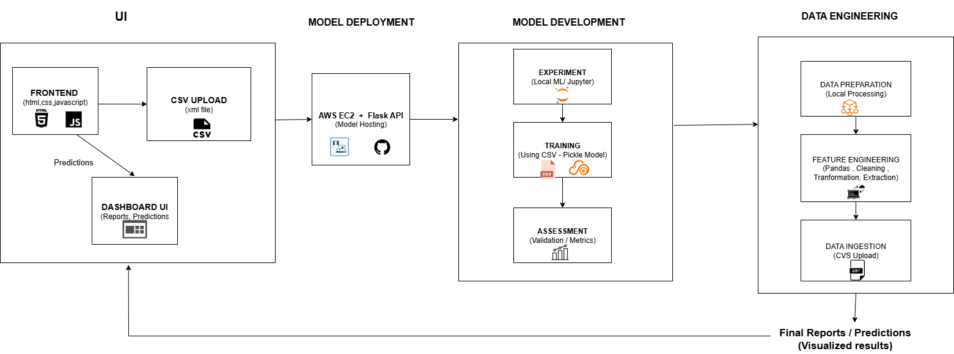

Slide 10
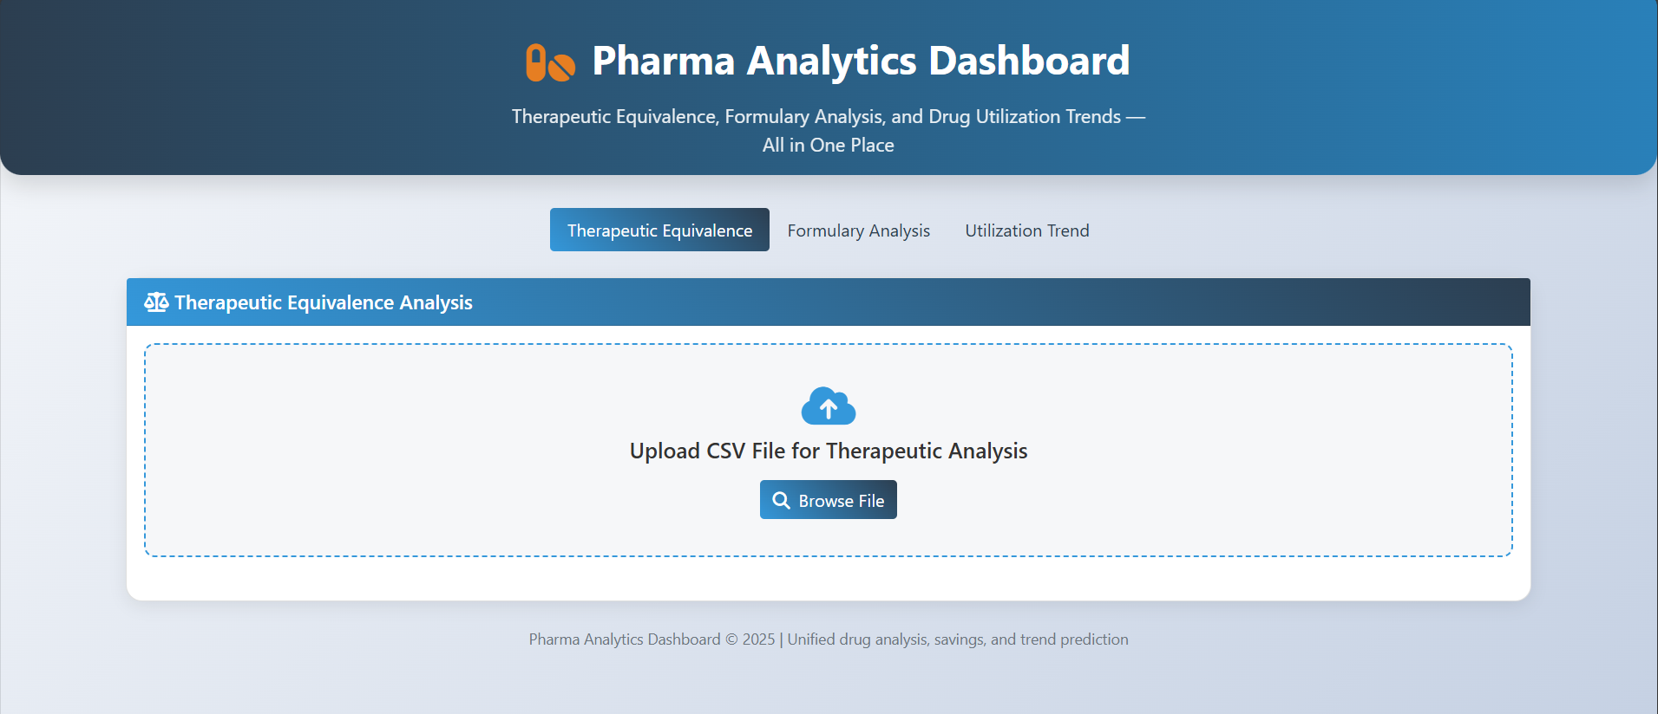

Slide 11
SAMPLE CODE
@app.route('/upload', methods=['POST'])
def upload_csv():
file = request.files['file'] # 📂 Get uploaded CSV
df = pd.read_csv(file) # 📊 Read into DataFrame
preds = trend_model.predict(df) # 🤖 Run ML prediction
return jsonify(preds.tolist()) # 📤 Return results as JSON

Slide 12
Issues Faced
🚩 Issues Faced in PBM Web Application
Dataset Compatibility
Data Quality Problems
Therapeutic Equivalence Mismatch
Model Loading Issue
✅ Workaround
Used a Kaggle dataset instead of the local dataset.
Kaggle data was clean, standardized, and compatible → model worked correctly.

Slide 13
WEBSITE LINK
🌐 Live Web Application (AWS Deployment)
Content: Click here to access: http://13.201.125.15:5000/

Slide 14

Thank you

